Slide 1
Probabilistic and Bayesian Analytics
Note to other teachers and users of these slides. Andrew would be delighted if you found this source material useful in giving your own lectures. Feel free to use these slides verbatim, or to modify them to fit your own needs. PowerPoint originals are available. If you make use of a significant portion of these slides in your own lecture, please include this message, or the following link to the source repository of Andrew’s tutorials: http://www.cs.cmu.edu/~awm/tutorials . Comments and corrections gratefully received.
Andrew W. Moore Professor
School of Computer Science Carnegie Mellon University
www.cs.cmu.edu/~awm awm@cs.cmu.edu
412-268-7599
Copyright © Andrew W. Moore
Slide 1
Probability
The world is a very uncertain place
30 years of Artificial Intelligence and Database research danced around this fact
And then a few AI researchers decided to use some ideas from the eighteenth century
Copyright © Andrew W. Moore
Slide 2

Slide 2
What we’re going to do
We will review the fundamentals of probability.
It’s really going to be worth it
In this lecture, you’ll see an example of probabilistic analytics in action: Bayes Classifiers
Copyright © Andrew W. Moore
Slide 3
Discrete Random Variables
A is a Boolean-valued random variable if A denotes an event, and there is some degree of uncertainty as to whether A occurs.
Examples
A = The US president in 2023 will be male
A = You wake up tomorrow with a headache
A = You have Ebola
Copyright © Andrew W. Moore
Slide 4

Slide 3
Probabilities
We write P(A) as “the fraction of possible worlds in which A is true”
We could at this point spend 2 hours on the philosophy of this.
But we won’t.
Copyright © Andrew W. Moore
Slide 5
Visualizing A
Event space of all possible worlds
Worlds in which A is true
Worlds in which A is False
P(A) = Area of reddish oval
Its area is 1
Copyright © Andrew W. Moore
Slide 6

Slide 4
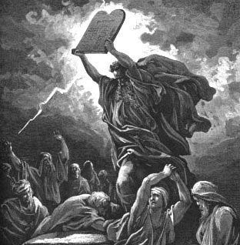
Copyright © Andrew W. Moore
The
Axioms
Of
Probabi
lity
Slide 7
The Axioms of Probability
0 <= P(A) <= 1
P(True) = 1
P(False) = 0
P(A or B) = P(A) + P(B) - P(A and B)
Where do these axioms come from? Were they “discovered”? Answers coming up later.
Copyright © Andrew W. Moore
Slide 8

Slide 5
Interpreting the axioms
0 <= P(A) <= 1
P(True) = 1
P(False) = 0
P(A or B) = P(A) + P(B) - P(A and B)
The area of A can’t get any smaller than 0
And a zero area would mean no world could ever have A true
Copyright © Andrew W. Moore
Slide 9
Interpreting the axioms
0 <= P(A) <= 1
P(True) = 1
P(False) = 0
P(A or B) = P(A) + P(B) - P(A and B)
The area of A can’t get any bigger than 1
And an area of 1 would mean all worlds will have A true
Copyright © Andrew W. Moore
Slide 10

Slide 6
Interpreting the axioms
0 <= P(A) <= 1
P(True) = 1
P(False) = 0
P(A or B) = P(A) + P(B) - P(A and B)
A
B
Copyright © Andrew W. Moore
Slide 11
Interpreting the axioms
0 <= P(A) <= 1
P(True) = 1
P(False) = 0
P(A or B) = P(A) + P(B) - P(A and B)
A
B
P(A or B)
P(A and B)
B
Simple addition and subtraction
Copyright © Andrew W. Moore
Slide 12

Slide 7
These Axioms are Not to be Trifled With
There have been attempts to do different methodologies for uncertainty
Fuzzy Logic
Three-valued logic
Dempster-Shafer
Non-monotonic reasoning
But the axioms of probability are the only system with this property:
If you gamble using them you can’t be unfairly exploited by an opponent using some other system [di Finetti 1931]
Copyright © Andrew W. Moore
Slide 13
Theorems from the Axioms
0 <= P(A) <= 1, P(True) = 1, P(False) = 0
P(A or B) = P(A) + P(B) - P(A and B)
From these we can prove:
P(not A) = P(~A) = 1-P(A)
How?
Copyright © Andrew W. Moore
Slide 14

Slide 8
Side Note
I am inflicting these proofs on you for two reasons:
These kind of manipulations will need to be second nature to you if you use probabilistic analytics in depth
Suffering is good for you
Copyright © Andrew W. Moore
Slide 15
Another important theorem
0 <= P(A) <= 1, P(True) = 1, P(False) = 0
P(A or B) = P(A) + P(B) - P(A and B)
From these we can prove:
P(A) = P(A ^ B) + P(A ^ ~B)
How?
Copyright © Andrew W. Moore
Slide 16

Slide 9
Multivalued Random Variables
Suppose A can take on more than 2 values
A is a random variable with arity k if it can take on exactly one value out of {v₁,v₂, .. v_{k}}
Thus…
P( A = v_{i} ∧ A = v _{j} ) = 0 if i ≠ j
P( A = v₁ ∨ A = v₂ ∨ A = v_{k} ) = 1
Copyright © Andrew W. Moore
Slide 17
An easy fact about Multivalued Random Variables:
Using the axioms of probability…
0 <= P(A) <= 1, P(True) = 1, P(False) = 0 P(A or B) = P(A) + P(B) - P(A and B)
And assuming that A obeys…
P( A = v_{i} ∧ A = v _{j} ) = 0 if i ≠ j
P( A = v₁ ∨ A = v₂ ∨ A = v_{k} ) = 1
P( A = v₁ ∨ A = v₂ ∨ A = v_{i} ) = ∑ P( A = v _{j} )
j =1
It’s easy to prove that
i
Copyright © Andrew W. Moore
Slide 18

Slide 10
An easy fact about Multivalued Random Variables:
Using the axioms of probability…
0 <= P(A) <= 1, P(True) = 1, P(False) = 0 P(A or B) = P(A) + P(B) - P(A and B)
And assuming that A obeys…
P( A = v_{i} ∧ A = v _{j} ) = 0 if i ≠ j
P( A = v₁ ∨ A = v₂ ∨ A = v_{k} ) = 1
P( A = v₁ ∨ A = v₂ ∨ A = v_{i} ) = ∑ P( A = v _{j} )
It’s easy to prove that
i
And thus we can prove
∑ P( A = v _{j} ) = 1
j =1
j =1
k
Copyright © Andrew W. Moore
Slide 19
Another fact about Multivalued Random Variables:
Using the axioms of probability…
0 <= P(A) <= 1, P(True) = 1, P(False) = 0 P(A or B) = P(A) + P(B) - P(A and B)
And assuming that A obeys…
P( A = v_{i} ∧ A = v _{j} ) = 0 if i ≠ j
P( A = v₁ ∨ A = v₂ ∨ A = v_{k} ) = 1
It’s easy to prove that
P(B ∧[ A = v₁ ∨ A = v₂ ∨ A = v_{i} ]) = ∑ P(B ∧ A = v _{j} )
j =1
i
Copyright © Andrew W. Moore
Slide 20

Slide 11
Another fact about Multivalued Random Variables:
Using the axioms of probability…
0 <= P(A) <= 1, P(True) = 1, P(False) = 0 P(A or B) = P(A) + P(B) - P(A and B)
And assuming that A obeys…
P( A = v_{i} ∧ A = v _{j} ) = 0 if i ≠ j
P( A = v₁ ∨ A = v₂ ∨ A = v_{k} ) = 1
It’s easy to prove that
i
P(B ∧[ A = v₁ ∨ A = v₂ ∨ A = v_{i} ]) = ∑ P(B ∧ A = v _{j} )
And thus we can prove
j =1
P(B) = ∑ P(B ∧ A = v _{j} )
j =1
k
Copyright © Andrew W. Moore
Slide 21
Elementary Probability in Pictures
P(~A) + P(A) = 1
Copyright © Andrew W. Moore
Slide 22

Slide 12
Elementary Probability in Pictures
P(B) = P(B ^ A) + P(B ^ ~A)
Copyright © Andrew W. Moore
Slide 23
Elementary Probability in Pictures
∑ P( A = v _{j} ) = 1
j =1
k
Copyright © Andrew W. Moore
Slide 24

Slide 13
P(B) = ∑ P(B ∧ A = v _{j} )
j =1
Elementary Probability in Pictures
k
Copyright © Andrew W. Moore
Slide 25
Conditional Probability
P(A|B) = Fraction of worlds in which B is true that also have A true
H = “Have a headache”
F = “Coming down with Flu”
P(H) = 1/10 P(F) = 1/40 P(H|F) = 1/2
“Headaches are rare and flu is rarer, but if you’re coming down with ‘flu there’s a 50-50 chance you’ll have a headache.”
F
H
Copyright © Andrew W. Moore
Slide 26

Slide 14
Conditional Probability
P(H|F) = Fraction of flu-inflicted worlds in which you have a headache
F
H
= #worlds with flu and headache
------------------------------------
#worlds with flu
H = “Have a headache”
F = “Coming down with Flu”
P(H) = 1/10 P(F) = 1/40 P(H|F) = 1/2
= Area of “H and F” region
------------------------------
Area of “F” region
= P(H ^ F)
----------- P(F)
Copyright © Andrew W. Moore
Slide 27
Definition of Conditional Probability
P(A ^ B) P(A|B) = -----------
P(B)
Corollary: The Chain Rule
P(A ^ B) = P(A|B) P(B)
Copyright © Andrew W. Moore
Slide 28

Slide 15
Probabilistic Inference
F
H
H = “Have a headache”
F = “Coming down with Flu”
P(H) = 1/10 P(F) = 1/40 P(H|F) = 1/2
One day you wake up with a headache. You think: “Drat! 50% of flus are associated with headaches so I must have a 50-50 chance of coming down with flu”
Is this reasoning good?
Copyright © Andrew W. Moore
Slide 29
Probabilistic Inference
H = “Have a headache”
F = “Coming down with Flu”
P(H) = 1/10 P(F) = 1/40 P(H|F) = 1/2
P(F ^ H) = …
F
H
P(F|H) = …
Copyright © Andrew W. Moore
Slide 30

Slide 16
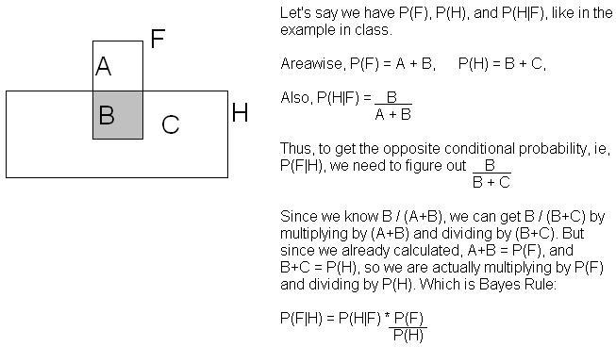
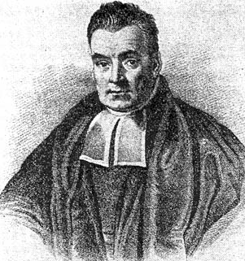
Another way to understand the intuition
Thanks to Jahanzeb Sherwani for contributing this explanation:
Copyright © Andrew W. Moore
Slide 31
What we just did…
P(A ^ B) P(A|B) P(B) P(B|A) = ----------- = ---------------
P(A) P(A)
This is Bayes Rule
Bayes, Thomas (1763) An essay towards solving a problem in the doctrine of chances. Philosophical Transactions of the Royal Society of London, 53:370-418
Copyright © Andrew W. Moore
Slide 32

Slide 17
Using Bayes Rule to Gamble
$1.00
The “Win” envelope has a dollar and four beads in it
The “Lose” envelope has three beads and no money
Trivial question: someone draws an envelope at random and offers to sell it to you. How much should you pay?
Copyright © Andrew W. Moore Slide 33
Using Bayes Rule to Gamble
$1.00
The “Win” envelope has a dollar and four beads in it
The “Lose” envelope has three beads and no money
Interesting question: before deciding, you are allowed to see one bead drawn from the envelope.
Suppose it’s black: How much should you pay? Suppose it’s red: How much should you pay?
Copyright © Andrew W. Moore Slide 34

Slide 18
Calculation…
$1.00
Copyright © Andrew W. Moore
Slide 35
More General Forms of Bayes Rule
P(A|B) =
P(B| A)P(A)
P(B| A)P(A) + P(B|~ A)P(~ A)
_{P(A|B∧ X) =} P(B| A∧ X)P(A∧ X)
P(B∧ X)
Copyright © Andrew W. Moore
Slide 36

Slide 19
More General Forms of Bayes Rule
P(A= v |B) =
P(B| A= v_{i} )P(A= v_{i} )
∑P(B| A= v_{k} )P(A= v_{k} )
k=1
i
n_{A}
Copyright © Andrew W. Moore
Slide 37
Useful Easy-to-prove facts
P( A | B)+P(¬A | B) = 1
∑ P( A = v_{k} | B) = 1
k =1
n_{A}
Copyright © Andrew W. Moore
Slide 38

Slide 20
The Joint Distribution
Example: Boolean variables A, B, C
Recipe for making a joint distribution of M variables:
Copyright © Andrew W. Moore
Slide 39
The Joint Distribution
Example: Boolean variables A, B, C
Recipe for making a joint distribution of M variables:
1. Make a truth table listing all combinations of values of your variables (if there are M Boolean variables then the table will have 2^{M} rows).
A | B | C
0 | 0 | 0
0 | 0 | 1
0 | 1 | 0
0 | 1 | 1
1 | 0 | 0
1 | 0 | 1
1 | 1 | 0
1 | 1 | 1
Copyright © Andrew W. Moore
Slide 40

Slide 21
The Joint Distribution
Example: Boolean variables A, B, C
Recipe for making a joint distribution of M variables:
Make a truth table listing all combinations of values of your variables (if there are M Boolean variables then the table will have 2^{M} rows).
For each combination of values, say how probable it is.
A | B | C | Prob
0 | 0 | 0 | 0.30
0 | 0 | 1 | 0.05
0 | 1 | 0 | 0.10
0 | 1 | 1 | 0.05
1 | 0 | 0 | 0.05
1 | 0 | 1 | 0.10
1 | 1 | 0 | 0.25
1 | 1 | 1 | 0.10
Copyright © Andrew W. Moore
Slide 41
The Joint Distribution
Example: Boolean variables A, B, C
Recipe for making a joint distribution of M variables:
Make a truth table listing all combinations of values of your variables (if there are M Boolean variables then the table will have 2^{M} rows).
For each combination of values, say how probable it is.
If you subscribe to the axioms of probability, those numbers must sum to 1.
 | A |  | B | C |  | Prob
 | 0 |  | 0 | 0 |  | 0.30
 | 0 |  | 0 | 1 |  | 0.05
 | 0 |  | 1 | 0 |  | 0.10
 | 0 |  | 1 | 1 |  | 0.05
 | 1 |  | 0 | 0 |  | 0.05
 | 1 |  | 0 | 1 |  | 0.10
 | 1 |  | 1 | 0 |  | 0.25
 | 1 |  | 1 | 1 |  | 0.10
 | A | 0.05 _{0.10} |  |  | 0.05
 |  | _{0.25} 0.10
 |  |  |  |  | 0.05 _{C}
 | 0.30 | _{B} 0.10
Copyright © Andrew W. Moore
Slide 42

Slide 22
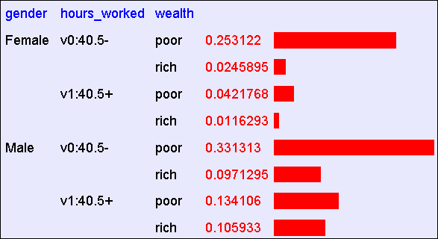
Using the Joint
One you have the JD you can ask for the probability of any logical expression involving your attribute
P(E) = ∑ P(row)
rows matching E
Copyright © Andrew W. Moore
Slide 43
Using the Joint
P(Poor Male) = 0.4654
P(E) = ∑ P(row)
rows matching E
Copyright © Andrew W. Moore
Slide 44

Slide 23
Using the Joint
P(Poor) = 0.7604
P(E) = ∑ P(row)
rows matching E
Copyright © Andrew W. Moore
Slide 45
Inference with the Joint
∑ P(row)
P(E | E ) =
P(E ∧ E )
=
rows matching E and E
1 2
∑ P(row)
rows matching E₂
Copyright © Andrew W. Moore
1 2
P(E )
1 2
2
Slide 46

Slide 24
Inference with the Joint
∑ P(row)
P(E | E ) =
P(E ∧ E )
=
rows matching E and E
1 2
∑ P(row)
rows matching E₂
Copyright © Andrew W. Moore
1 2
P(E )
1 2
2
P(Male | Poor) = 0.4654 / 0.7604 = 0.612
Slide 47
Inference is a big deal
I’ve got this evidence. What’s the chance that this conclusion is true?
I’ve got a sore neck: how likely am I to have meningitis?
I see my lights are out and it’s 9pm. What’s the chance my spouse is already asleep?
Copyright © Andrew W. Moore
Slide 48

Slide 25
Inference is a big deal
I’ve got this evidence. What’s the chance that this conclusion is true?
I’ve got a sore neck: how likely am I to have meningitis?
I see my lights are out and it’s 9pm. What’s the chance my spouse is already asleep?
Copyright © Andrew W. Moore
Slide 49
Inference is a big deal
I’ve got this evidence. What’s the chance that this conclusion is true?
I’ve got a sore neck: how likely am I to have meningitis?
I see my lights are out and it’s 9pm. What’s the chance my spouse is already asleep?
There’s a thriving set of industries growing based around Bayesian Inference. Highlights are: Medicine, Pharma, Help Desk Support, Engine Fault Diagnosis
Copyright © Andrew W. Moore
Slide 50

Slide 26
Where do Joint Distributions come from?
Idea One: Expert Humans
Idea Two: Simpler probabilistic facts and some algebra
Example: Suppose you knew
P(A) = 0.7 P(C|A^B) = 0.1
P(C|A^~B) = 0.8
Then you can automatically compute the JD using the chain rule
P(B|A) = 0.2 P(C|~A^B) = 0.3
P(B|~A) = 0.1 P(C|~A^~B) = 0.1
P(A=x ^ B=y ^ C=z) = P(C=z|A=x^ B=y) P(B=y|A=x) P(A=x)
In another lecture: Bayes Nets, a systematic way to do this.
Copyright © Andrew W. Moore
Slide 51
Where do Joint Distributions come from?
Idea Three: Learn them from data!
Prepare to see one of the most impressive learning algorithms you’ll come across in the entire course….
Copyright © Andrew W. Moore
Slide 52

Slide 27
Learning a joint distribution
Build a JD table for your attributes in which the probabilities are unspecified
The fill in each row with
P^{ˆ}(row) =
records matching row
A | B | C | Prob
0 | 0 | 0 | ?
0 | 0 | 1 | ?
0 | 1 | 0 | ?
0 | 1 | 1 | ?
1 | 0 | 0 | ?
1 | 0 | 1 | ?
1 | 1 | 0 | ?
1 | 1 | 1 | ?
total number of records
A | B | C | Prob
0 | 0 | 0 | 0.30
0 | 0 | 1 | 0.05
0 | 1 | 0 | 0.10
0 | 1 | 1 | 0.05
1 | 0 | 0 | 0.05
1 | 0 | 1 | 0.10
1 | 1 | 0 | 0.25
1 | 1 | 1 | 0.10
Fraction of all records in which A and B are True but C is False
Copyright © Andrew W. Moore
Slide 53
Example of Learning a Joint
This Joint was obtained by learning from three attributes in the UCI “Adult” Census Database [Kohavi 1995]
Copyright © Andrew W. Moore
Slide 54

Slide 28
Where are we?
We have recalled the fundamentals of probability
We have become content with what JDs are and how to use them
And we even know how to learn JDs from data.
Copyright © Andrew W. Moore
Slide 55
Density Estimation
Our Joint Distribution learner is our first example of something called Density Estimation
A Density Estimator learns a mapping from a set of attributes to a Probability
Input Attributes
Density Estimator
Probability
Copyright © Andrew W. Moore
Slide 56

Slide 29
Density Estimation
Compare it against the two other major kinds of models:
Input
Attributes
Classifier
Prediction of categorical output
Input Attributes
Density Estimator
Probability
Input Attributes
Regressor
Prediction of real-valued output
Copyright © Andrew W. Moore
Slide 57
Evaluating Density Estimation
Test-set criterion for estimating performance on future data*
* See the Decision Tree or Cross Validation lecture for more detail
Input Attributes
Classifier
Prediction of categorical output
Test set Accuracy
Input Attributes
Density Estimator
Probability
?
Input Attributes
Regressor
Prediction of real-valued output
Test set Accuracy
Copyright © Andrew W. Moore
Slide 58

Slide 30
Evaluating a density estimator
Given a record x, a density estimator M can tell you how likely the record is:
P^{ˆ}(x|M )
Given a dataset with R records, a density estimator can tell you how likely the dataset is:
(Under the assumption that all records were independently generated from the Density Estimator’s JD)
P^{ˆ}(dataset|M ) = P^{ˆ}(x₁ ∧ x₂ K∧ x_{R}|M ) = ∏ P^{ˆ}(x_{k}|M )
k =1
R
Copyright © Andrew W. Moore
Slide 59
A small dataset: Miles Per Gallon
mpg | modelyear | maker
good | 75to78 | asia
bad | 70to74 | america
bad | 75to78 | europe
bad | 70to74 | america
bad | 70to74 | america
bad | 70to74 | asia
bad | 70to74 | asia
bad | 75to78 | america
: | : | :
: | : | :
: | : | :
bad | 70to74 | america
good | 79to83 | america
bad | 75to78 | america
good | 79to83 | america
bad | 75to78 | america
good | 79to83 | america
good | 79to83 | america
bad | 70to74 | america
good | 75to78 | europe
bad | 75to78 | europe
192
Training Set Records
From the UCI repository (thanks to Ross Quinlan)
Copyright © Andrew W. Moore
Slide 60

Slide 31
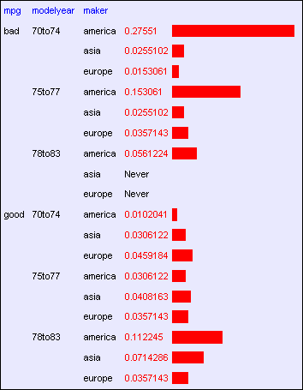
A small dataset: Miles Per Gallon
mpg | modelyear | maker
good | 75to78 | asia
bad | 70to74 | america
bad | 75to78 | europe
bad | 70to74 | america
bad | 70to74 | america
bad | 70to74 | asia
bad | 70to74 | asia
bad | 75to78 | america
: | : | :
: | : | :
: | : | :
bad | 70to74 | america
good | 79to83 | america
bad | 75to78 | america
good | 79to83 | america
bad | 75to78 | america
good | 79to83 | america
good | 79to83 | america
bad | 70to74 | america
good | 75to78 | europe
bad | 75to78 | europe
192
Training Set Records
Copyright © Andrew W. Moore
Slide 61
A small dataset: Miles Per Gallon
192 Training Set | mpg | modelyear | maker
 | good | 75to78 | asia
 | bad | 70to74 | america
 | bad | 75to78 | europe
 | bad | 70to74 | america
 | bad | 70to74 | america
 | bad | 70to74 | asia
 | bad | 70to74 | asia
R P^{ˆ}(dataset|M ) = P^{ˆ}(x₁ ∧ x₂ K∧ x_{R}|M ) = ∏ P^{ˆ}(x_{k}|M ) k =1 = (in this case) = 3.4 ×10⁻²⁰³
_{Records} bad 75to78 america
: : :
: : :
: : :
bad 70to74 america
good 79to83 america bad 75to78 america good 79to83 america bad 75to78 america good 79to83 america good 79to83 america bad 70to74 america good 75to78 europe bad 75to78 europe
Copyright © Andrew W. Moore
Slide 62

Slide 32
Log Probabilities
Since probabilities of datasets get so small we usually use log probabilities
R R
log P^{ˆ}(dataset|M ) = log∏ P^{ˆ}(x_{k}|M ) = ∑log P^{ˆ}(x_{k}|M )
k =1 k =1
Copyright © Andrew W. Moore
Slide 63
A small dataset: Miles Per Gallon
192 Training Set | mpg | modelyear | maker
 | good | 75to78 | asia
 | bad | 70to74 | america
 | bad | 75to78 | europe
 | bad | 70to74 | america
 | bad | 70to74 | america
 | bad | 70to74 | asia
 | bad | 70to74 | asia
R R log P^{ˆ}(dataset|M ) = log∏ P^{ˆ}(x_{k}|M ) = ∑log P^{ˆ}(x_{k}|M ) k =1 k =1 = (in this case) = − 466.19
_{Records} bad 75to78 america
: : :
: : :
: : :
bad 70to74 america
good 79to83 america bad 75to78 america good 79to83 america bad 75to78 america good 79to83 america good 79to83 america bad 70to74 america good 75to78 europe bad 75to78 europe
Copyright © Andrew W. Moore
Slide 64

Slide 33
Summary: The Good News
We have a way to learn a Density Estimator from data.
Density estimators can do many good things…
Can sort the records by probability, and thus spot weird records (anomaly detection)
Can do inference: P(E1|E2)
Automatic Doctor / Help Desk etc
Ingredient for Bayes Classifiers (see later)
Copyright © Andrew W. Moore
Slide 65
Summary: The Bad News
Density estimation by directly learning the joint is trivial, mindless and dangerous
Copyright © Andrew W. Moore
Slide 66

Slide 34
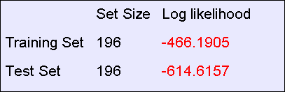
Using a test set
An independent test set with 196 cars has a worse log likelihood
(actually it’s a billion quintillion quintillion quintillion quintillion times less likely)
….Density estimators can overfit. And the full joint density estimator is the overfittiest of them all!
Copyright © Andrew W. Moore
Slide 67
Overfitting Density Estimators
If this ever happens, it means there are certain combinations that we learn are impossible
R R
log P^{ˆ}(testset|M ) = log∏ P^{ˆ}(x_{k}|M ) = ∑log P^{ˆ}(x_{k}|M )
k =1 k =1
= − ∞ if for any k P^{ˆ}(x_{k}|M ) = 0
Copyright © Andrew W. Moore
Slide 68

Slide 35
Using a test set
The only reason that our test set didn’t score -infinity is that my code is hard-wired to always predict a probability of at least one in 10²⁰
We need Density Estimators that are less prone to overfitting
Copyright © Andrew W. Moore
Slide 69
Naïve Density Estimation
The problem with the Joint Estimator is that it just mirrors the training data.
We need something which generalizes more usefully.
The naïve model generalizes strongly:
Assume that each attribute is distributed independently of any of the other attributes.
Copyright © Andrew W. Moore
Slide 70

Slide 36
Independently Distributed Data
Let x[i] denote the i’th field of record x.
The independently distributed assumption says that for any i,v, u₁ u₂… u_{i-1} u_{i+1}… u_{M}
P(x[i] = v | x[1] = u₁ , x[2] = u₂ ,K x[i −1] = u_{i−1} , x[i +1] = u_{i+1} ,K x[M ] = u_{M} )
= P(x[i] = v)
Or in other words, x[i] is independent of
{x[1],x[2],..x[i-1], x[i+1],…x[M]}
This is often written as
x[i] ⊥ {x[1], x[2],K x[i − 1], x[i + 1],K x[M ]}
Copyright © Andrew W. Moore
Slide 71
A note about independence
Assume A and B are Boolean Random Variables. Then
“A and B are independent” if and only if
P(A|B) = P(A)
“A and B are independent” is often notated
as
A ⊥ B
Copyright © Andrew W. Moore
Slide 72

Slide 37
Independence Theorems
Assume P(A|B) = P(A) • Assume P(A|B) = P(A)
Then P(A^B) = • Then P(B|A) =
= P(A) P(B)
= P(B)
Slide 73
Copyright © Andrew W. Moore
Independence Theorems
Assume P(A|B) = P(A) • Assume P(A|B) = P(A)
Then P(~A|B) = • Then P(A|~B) =
= P(~A)
= P(A)
Slide 74
Copyright © Andrew W. Moore

Slide 38
Multivalued Independence
For multivalued Random Variables A and B,
A ⊥ B
if and only if
∀u, v : P( A = u | B = v) = P( A = u)
from which you can then prove things like…
∀u, v : P( A = u ∧ B = v) = P( A = u)P(B = v)
∀u, v : P(B = v | A = v) = P(B = v)
Copyright © Andrew W. Moore
Slide 75
Back to Naïve Density Estimation
Let x[i] denote the i’th field of record x:
Naïve DE assumes x[i] is independent of {x[1],x[2],..x[i-1], x[i+1],…x[M]}
Example:
Suppose that each record is generated by randomly shaking a green dice and a red dice
Dataset 1: A = red value, B = green value
Dataset 2: A = red value, B = sum of values
Dataset 3: A = sum of values, B = difference of values
Which of these datasets violates the naïve assumption?
Copyright © Andrew W. Moore
Slide 76

Slide 39
Using the Naïve Distribution
Once you have a Naïve Distribution you can easily compute any row of the joint distribution.
Suppose A, B, C and D are independently distributed. What is P(A^~B^C^~D)?
Copyright © Andrew W. Moore
Slide 77
Using the Naïve Distribution
Once you have a Naïve Distribution you can easily compute any row of the joint distribution.
Suppose A, B, C and D are independently distributed. What is P(A^~B^C^~D)?
= P(A|~B^C^~D) P(~B^C^~D)
= P(A) P(~B^C^~D)
= P(A) P(~B|C^~D) P(C^~D)
= P(A) P(~B) P(C^~D)
= P(A) P(~B) P(C|~D) P(~D)
= P(A) P(~B) P(C) P(~D)
Copyright © Andrew W. Moore Slide 78

Slide 40
Naïve Distribution General Case
Suppose x[1], x[2], … x[M] are independently distributed.
P(x[1] = u₁ , x[2] = u₂ ,K x[M ] = u_{M} ) = ∏ P(x[k ] = u_{k} )
k =1
So if we have a Naïve Distribution we can construct any row of the implied Joint Distribution on demand.
So we can do any inference
But how do we learn a Naïve Density Estimator?
M
Copyright © Andrew W. Moore
Slide 79
Learning a Naïve Density Estimator
_{Pˆ(x[i] = u) =} # records in which x[i] = u
total number of records
Another trivial learning algorithm!
Copyright © Andrew W. Moore
Slide 80

Slide 41
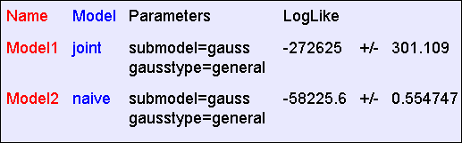
Contrast
Joint DE | Naïve DE
Can model anything | Can model only very boring distributions
No problem to model “C is a noisy copy of A” | Outside Naïve’s scope
Given 100 records and more than 6 Boolean attributes will screw up badly | Given 100 records and 10,000 multivalued attributes will be fine
Copyright © Andrew W. Moore
Slide 81
Empirical Results: “Hopeless”
The “hopeless” dataset consists of 40,000 records and 21 Boolean attributes called a,b,c, … u. Each attribute in each record is generated 50-50 randomly as 0 or 1.
Average test set log probability during 10 folds of k-fold cross-validation*
Described in a future Andrew lecture
Despite the vast amount of data, “Joint” overfits hopelessly and does much worse
Copyright © Andrew W. Moore
Slide 82

Slide 42
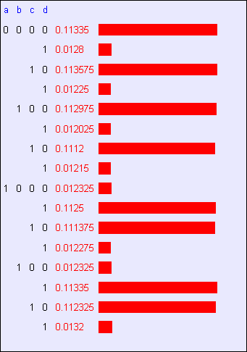
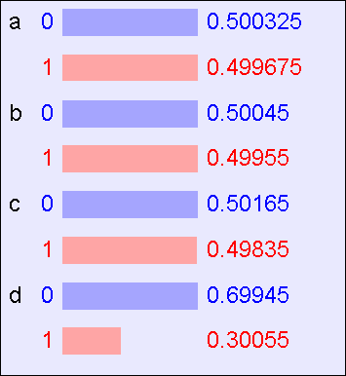
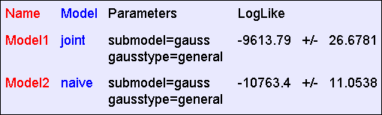
Empirical Results: “Logical”
The “logical” dataset consists of 40,000 records and 4 Boolean attributes called a,b,c,d where a,b,c are generated 50-50 randomly as 0 or 1. D = A^~C, except that in 10% of records it is flipped
The DE learned by “Joint”
The DE learned by “Naive”
Copyright © Andrew W. Moore
Slide 83
Empirical Results: “Logical”
The “logical” dataset consists of 40,000 records and 4 Boolean attributes called a,b,c,d where a,b,c are generated 50-50 randomly as 0 or 1. D = A^~C, except that in 10% of records it is flipped
The DE
learned by “Joint”
The DE learned by “Naive”
Copyright © Andrew W. Moore
Slide 84

Slide 43
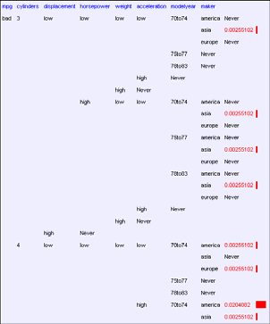
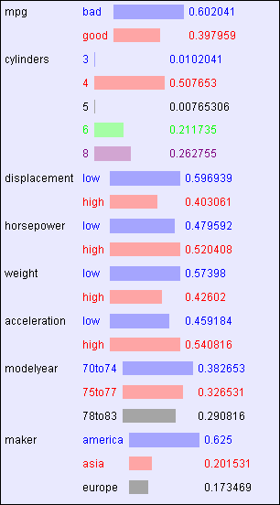
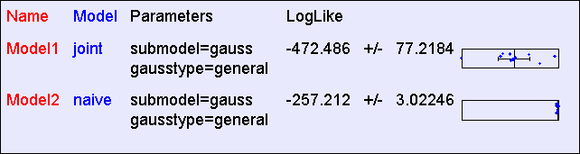
Empirical Results: “MPG”
The “MPG” dataset consists of 392 records and 8 attributes
A tiny part of the DE learned by “Joint”
The DE learned by “Naive”
Copyright © Andrew W. Moore
Slide 85
Empirical Results: “MPG”
The “MPG” dataset consists of 392 records and 8 attributes
A tiny part of
the DE learned by “Joint”
The DE learned by “Naive”
Copyright © Andrew W. Moore
Slide 86

Slide 44
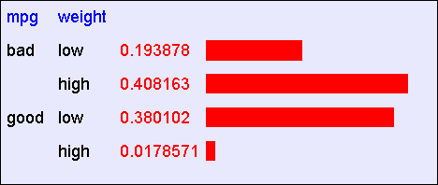
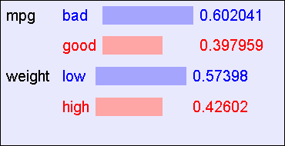
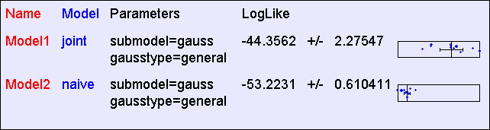
Empirical Results: “Weight vs. MPG”
Suppose we train only from the “Weight” and “MPG” attributes
The DE learned by “Joint”
The DE learned by “Naive”
Copyright © Andrew W. Moore
Slide 87
Empirical Results: “Weight vs. MPG”
Suppose we train only from the “Weight” and “MPG” attributes
The DE
learned by “Joint”
The DE learned by “Naive”
Copyright © Andrew W. Moore
Slide 88

Slide 45
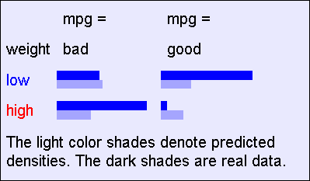
“Weight vs. MPG”: The best that Naïve can do
The DE
learned by
“Joint” _{The DE}
learned by
“Naive”
Copyright © Andrew W. Moore
Slide 89
Reminder: The Good News
We have two ways to learn a Density Estimator from data.
*In other lectures we’ll see vastly more impressive Density Estimators (Mixture Models, Bayesian Networks, Density Trees, Kernel Densities and many more)
Density estimators can do many good things…
Anomaly detection
Can do inference: P(E1|E2) Automatic Doctor / Help Desk etc
Ingredient for Bayes Classifiers
Copyright © Andrew W. Moore Slide 90

Slide 46


Bayes Classifiers
A formidable and sworn enemy of decision trees
Input
Attributes
Classifier
Prediction of categorical output
DT
BC
Copyright © Andrew W. Moore
Slide 91
How to build a Bayes Classifier
Assume you want to predict output Y which has arity n_{Y} and values
v₁, v₂, … v_{ny}.
Assume there are m input attributes called X₁, X₂, … X_{m}
Break dataset into n_{Y} smaller datasets called DS₁, DS₂, … DS_{ny}.
Define DS_{i} = Records in which Y=v_{i}
For each DS_{i} , learn Density Estimator M_{i} to model the input distribution among the Y=v_{i} records.
Copyright © Andrew W. Moore
Slide 92

Slide 47
How to build a Bayes Classifier
Assume you want to predict output Y which has arity n_{Y} and values
v₁, v₂, … v_{ny}.
Assume there are m input attributes called X₁, X₂, … X_{m}
Break dataset into n_{Y} smaller datasets called DS₁, DS₂, … DS_{ny}.
Define DS_{i} = Records in which Y=v_{i}
For each DS_{i} , learn Density Estimator M_{i} to model the input distribution among the Y=v_{i} records.
M_{i} estimates P(X₁, X₂, … X_{m} | Y=v_{i} )
Copyright © Andrew W. Moore
Slide 93
How to build a Bayes Classifier
Assume you want to predict output Y which has arity n_{Y} and values
v₁, v₂, … v_{ny}.
Assume there are m input attributes called X₁, X₂, … X_{m}
Break dataset into n_{Y} smaller datasets called DS₁, DS₂, … DS_{ny}.
Define DS_{i} = Records in which Y=v_{i}
For each DS_{i} , learn Density Estimator M_{i} to model the input distribution among the Y=v_{i} records.
M_{i} estimates P(X₁, X₂, … X_{m} | Y=v_{i} )
Idea: When a new set of input values (X₁ = u₁, X₂ = u₂, …. X_{m}
= u_{m}) come along to be evaluated predict the value of Y that makes P(X₁, X₂, … X_{m} | Y=v_{i} ) most likely
Y ^{predict} = argmax P( X = u L X = u | Y = v)
v
Is this a good idea?
1 1 m m
Copyright © Andrew W. Moore
Slide 94

Slide 48
How to build a Bayes Classifier
Assume you want to predict output Y which has arity n_{Y} and values
v₁, v₂, … v_{ny}.
Assume there are m input attrib
Break dataset into n_{Y} smaller da
Define DS_{i} = Records in which Y
For each DS_{i} , learn Density Est distribution among the Y=v_{i} rec
M_{i} estimates P(X₁, X₂, … X_{m} | Y=v_{i} )
Idea: When a new set of input values (X₁ = u₁, X₂ = u₂, …. X_{m}
= u_{m}) come along to be evaluated predict the value of Y that makes P(X₁, X₂, … X_{m} | Y=v_{i} ) most likely
This is a Maximum Likelihood classifier.
It can get silly if some Ys are very unlikely
utes called X₁, X₂, … X_{m}
tasets called DS₁, DS₂, … DS_{ny}.
=v_{i}
imator M_{i} to model the input ords.
Y ^{predict} = argmax P( X = u L X = u | Y = v)
v
Is this a good idea?
1 1 m m
Copyright © Andrew W. Moore
Slide 95
How to build a Bayes Classifier
Assume you want to predict output Y which has arity n_{Y} and values
v₁, v₂, … v_{ny}.
Assume there are m input attributes called X₁, X₂, … X_{m}
Break dataset into n_{Y} smaller datasets called DS₁, DS₂, … DS_{ny}.
Define DS_{i} = Records in which Y=v_{i}
For each DS_{i} , learn Density Estimator M_{i} to model the input distribution among the Y=v_{i} records.
M_{i} estimates P(X₁, X₂, … X_{m} | Y=v_{i} )
Idea: When a new set of input values (X₁ = u₁, X₂ = u₂, …. X_{m}
= u_{m}) come along to be evaluated predict the value of Y that makes P(Y=v_{i} | X₁, X₂, … X_{m}) most likely
Much Better Idea
Y ^{predict} = argmax P(Y = v | X = u L X = u )
v
Is this a good idea?
1 1 m m
Copyright © Andrew W. Moore
Slide 96

Slide 49
Terminology
MLE (Maximum Likelihood Estimator):
Y ^{predict} = argmax P( X = u L X = u | Y = v)
v
1 1 m m
MAP (Maximum A-Posteriori Estimator):
Y ^{predict} = argmax P(Y = v | X = u L X = u )
v
Copyright © Andrew W. Moore
1 1 m m
Slide 97
Getting what we need
Y ^{predict} = argmax P(Y = v | X = u L X = u )
v
Copyright © Andrew W. Moore
1 1 m m
Slide 98

Slide 50
Getting a posterior probability
P(Y = v | X₁ = u₁ L X_{m} = u_{m} )
=
=
P( X₁ = u₁ L X_{m} = u_{m} | Y = v)P(Y = v) P( X₁ = u₁ L X_{m} = u_{m} )
P( X₁ = u₁ L X_{m} = u_{m} | Y = v)P(Y = v)
∑ P( X₁ = u₁ L X_{m} = u_{m} | Y = v _{j} )P(Y = v _{j} )
j =1
n_{Y}
Copyright © Andrew W. Moore
Slide 99
Bayes Classifiers in a nutshell
Learn the distribution over inputs for each value Y.
This gives P(X₁, X₂, … X_{m} | Y=v_{i} ).
Estimate P(Y=v_{i} ). as fraction of records with Y=v_{i} .
For a new prediction:
Y ^{predict} = argmax P(Y = v | X = u L X = u )
v
1 1 m m
= argmax P( X₁ = u₁ L X_{m} = u_{m} | Y = v)P(Y = v)
v
Copyright © Andrew W. Moore
Slide 100

Slide 51
Bayes Classifiers in a nutshell
Learn the distribution over inputs for each value Y.
This gives P(X₁, X₂, … X_{m} | Y=v_{i} ).
Estimate P(Y=v_{i} ). as fraction of records with Y=v_{i} .
We can use our favorite
4. For a new prediction:
Density Estimator here.
Y ^{predict} = argmax P(Y = v | X = u L X = u )
v
1 Rig1ht nowm we hmave two
= argmax P( X = u L X
= u º| Y^{ptio}=^{ns}v:)P(Y = v)
v
1 1
m m
•Joint Density Estimator
•Naïve Density Estimator
Copyright © Andrew W. Moore
Slide 101
Joint Density Bayes Classifier
Y ^{predict} = argmax P( X = u L X = u | Y = v)P(Y = v)
1 1 m m
v
In the case of the joint Bayes Classifier this
degenerates to a very simple rule:
Y^{predict} = the most common value of Y among records in which X₁ = u₁, X₂ = u₂, …. X_{m} = u_{m}.
Note that if no records have the exact set of inputs X₁
= u₁, X₂ = u₂, …. X_{m} = u_{m}, then P(X₁, X₂, … X_{m} | Y=v_{i} )
= 0 for all values of Y.
In that case we just have to guess Y’s value
Copyright © Andrew W. Moore
Slide 102

Slide 52
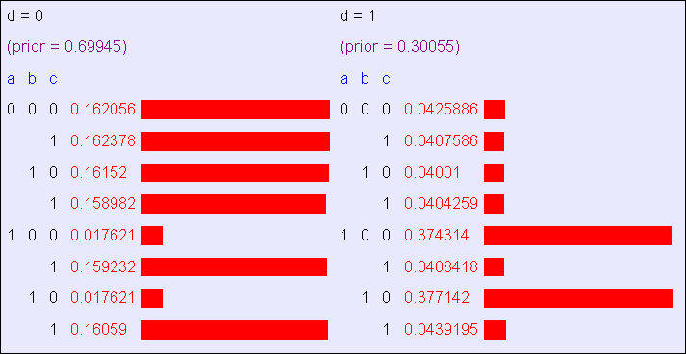
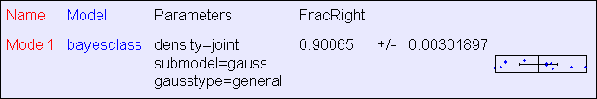
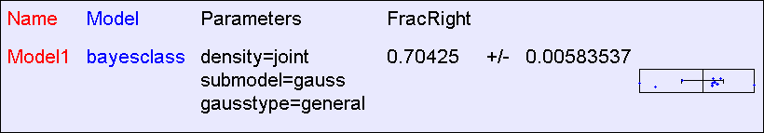
Joint BC Results: “Logical”
The “logical” dataset consists of 40,000 records and 4 Boolean attributes called a,b,c,d where a,b,c are generated 50-50 randomly as 0 or 1. D = A^~C, except that in 10% of records it is flipped
The Classifier learned by “Joint BC”
Copyright © Andrew W. Moore
Slide 103
Joint BC Results: “All Irrelevant”
The “all irrelevant” dataset consists of 40,000 records and 15 Boolean attributes called a,b,c,d..o where a,b,c are generated 50-50 randomly as 0 or 1. v (output) = 1 with probability 0.75, 0 with prob 0.25
Copyright © Andrew W. Moore
Slide 104

Slide 53
Naïve Bayes Classifier
Y ^{predict} = argmax P( X = u L X = u | Y = v)P(Y = v)
v
1 1 m m
In the case of the naive Bayes Classifier this can be simplified:
n_{Y}
Y ^{predict} = argmax P(Y = v)∏ P( X = u | Y = v)
v
j =1
j j
Copyright © Andrew W. Moore
Slide 105
Naïve Bayes Classifier
Y ^{predict} = argmax P( X = u L X = u | Y = v)P(Y = v)
v
1 1 m m
In the case of the naive Bayes Classifier this can be simplified:
n_{Y}
Y ^{predict} = argmax P(Y = v)∏ P( X = u | Y = v)
v
j j
j =1
Technical Hint:
If you have 10,000 input attributes that product will underflow in floating point math. You should use logs:
⎛
n_{Y ⎞}
Y = argmax⎜log P(Y = v) + ∑log P( X _{j} = u _{j} | Y = v)⎟
predict
⎝
⎠
v
j =1
Copyright © Andrew W. Moore
Slide 106

Slide 54
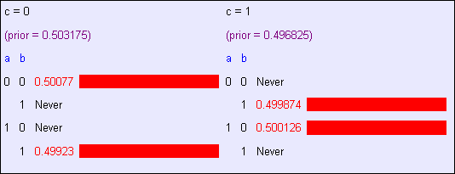
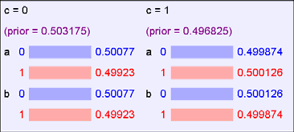
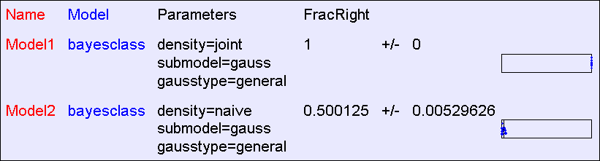
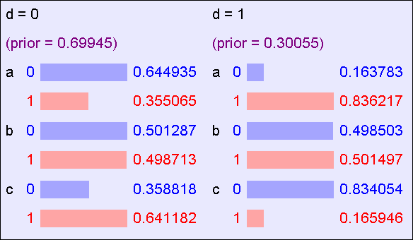
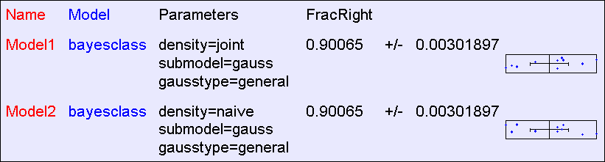
BC Results: “XOR”
The “XOR” dataset consists of 40,000 records and 2 Boolean inputs called a and b, generated 50-50 randomly as 0 or 1. c (output) = a XOR b
The Classifier learned by “Joint BC”
The Classifier learned by “Naive BC”
Copyright © Andrew W. Moore
Slide 107
Naive BC Results: “Logical”
The “logical” dataset consists of 40,000 records and 4 Boolean attributes called a,b,c,d where a,b,c are generated 50-50 randomly as 0 or 1. D = A^~C, except that in 10% of records it is flipped
The Classifier learned by “Naive BC”
Copyright © Andrew W. Moore
Slide 108

Slide 55
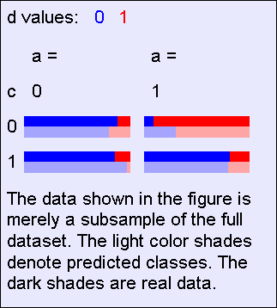
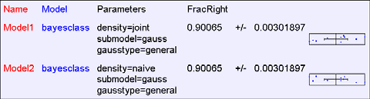
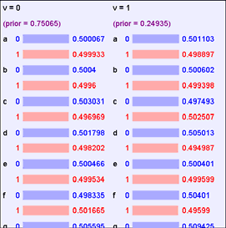
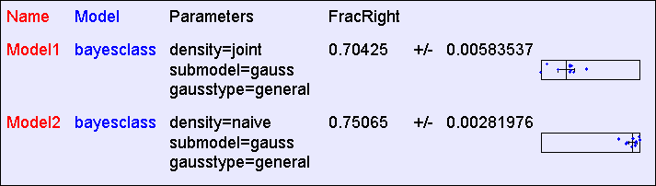
Naive BC Results: “Logical”
The “logical” dataset consists of 40,000 records and 4 Boolean attributes called a,b,c,d where a,b,c are generated 50-50 randomly as 0 or 1. D = A^~C, except that in 10% of records it is flipped
This result surprised Andrew until he had thought about it a little
The Classifier learned by “Joint BC”
Copyright © Andrew W. Moore
Slide 109
Naïve BC Results: “All Irrelevant”
The “all irrelevant” dataset consists of 40,000 records and 15 Boolean attributes called a,b,c,d..o where a,b,c are generated 50-50 randomly as 0 or 1. v (output) = 1 with
probability 0.75, 0 with prob 0.25
The Classifier learned by “Naive BC”
Copyright © Andrew W. Moore
Slide 110

Slide 56
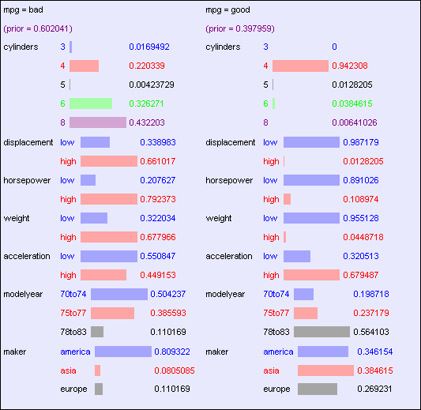
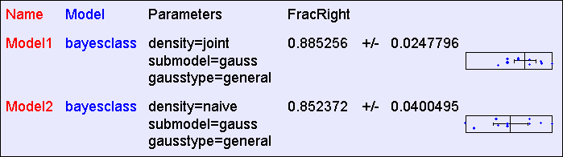
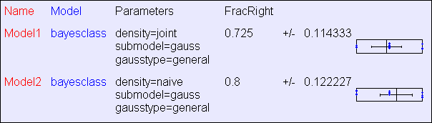
BC Results: “MPG”: 392
records
The Classifier learned by “Naive BC”
Copyright © Andrew W. Moore
Slide 111
BC Results: “MPG”: 40
records
Copyright © Andrew W. Moore
Slide 112

Slide 57
More Facts About Bayes Classifiers
Many other density estimators can be slotted in*.
Density estimation can be performed with real-valued inputs*
Bayes Classifiers can be built with real-valued inputs*
Rather Technical Complaint: Bayes Classifiers don’t try to be maximally discriminative---they merely try to honestly model what’s going on*
Zero probabilities are painful for Joint and Naïve. A hack (justifiable with the magic words “Dirichlet Prior”) can help*.
Naïve Bayes is wonderfully cheap. And survives 10,000 attributes cheerfully!
*See future Andrew Lectures
Copyright © Andrew W. Moore
Slide 113
What you should know
Probability
Fundamentals of Probability and Bayes Rule
What’s a Joint Distribution
How to do inference (i.e. P(E1|E2)) once you have a JD
Density Estimation
What is DE and what is it good for
How to learn a Joint DE
How to learn a naïve DE
Copyright © Andrew W. Moore
Slide 114

Slide 58
What you should know
Bayes Classifiers
How to build one
How to predict with a BC
Contrast between naïve and joint BCs
Copyright © Andrew W. Moore
Slide 115
Interesting Questions
Suppose you were evaluating NaiveBC, JointBC, and Decision Trees
Invent a problem where only NaiveBC would do well
Invent a problem where only Dtree would do well
Invent a problem where only JointBC would do well
Invent a problem where only NaiveBC would do poorly
Invent a problem where only Dtree would do poorly
Invent a problem where only JointBC would do poorly
Copyright © Andrew W. Moore
Slide 116

